Slide 1
Gui intro

Slide 2
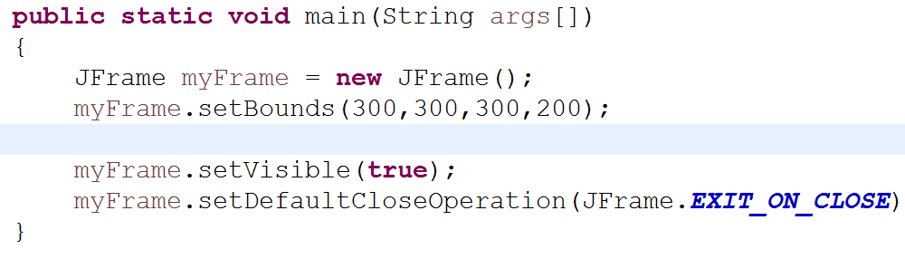
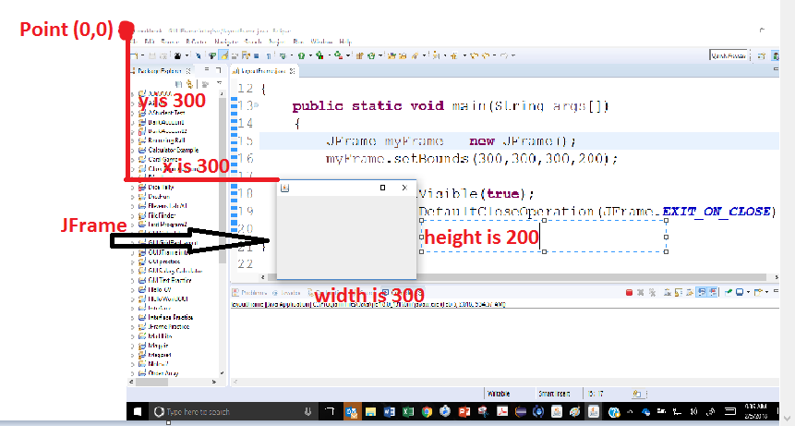
Jframe
A JFrame is the window in which the GUI program will be displayed. In order to se it you must set its visibility. You will also want to set its location and size. You can do each individually or at the same size with the setBounds method.
The point (0,0) is the top left corner.
X and Y values increase as you move
down or right.
Always the last two lines

Slide 3
Components and Containers
Components are all of the things that you see and interact with on the screen.
We will start with the following:
JLabel – used to display text (not interactive)
JTextField – used to get text from user
Jbutton – command button used to perform an action
Containers: can hold components. A JFrame is a container. A JPanel is both a component and a container. (Can be added as well as hold other components

Slide 4
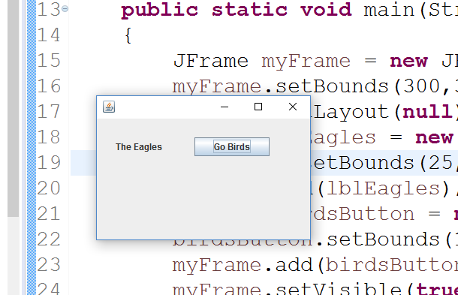
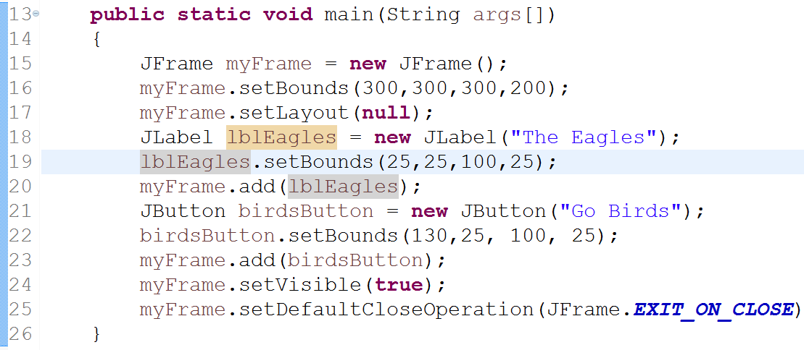
Adding objects to the Frame
We will start by using no “Layout” . We will learn layouts later. For now, set the layout to null.
Add objects to the container using the add method. Make sure to set their size and location (or both using setBounds)
JLabel
JButton

Slide 5
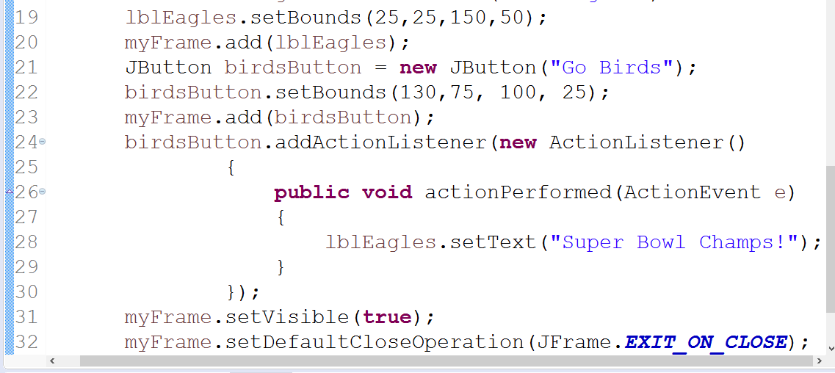
Action Listeners
Action Listeners are how we allow the user to interact with the components on the screen.
ActionListener is an interface which requires the method actionPerformed. We often write a separate class directly within the class where we are creating the JFrame to create the ActionListener. We add an ActionListener to a JComponent with the addActionListener method
The class that we are
Creating within our class.
This is the action listener
New code for Action Listerner
I had to adjust my bounds so that
Things showed up nicely.

Slide 6
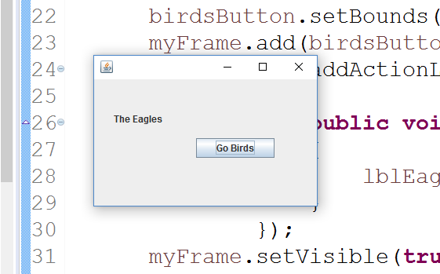
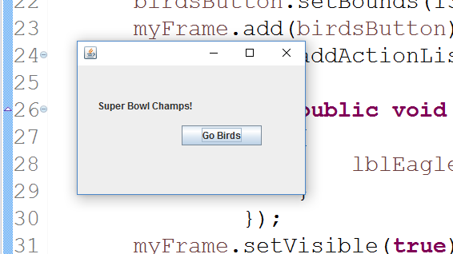
Action Listener in action
Before click After click

Slide 7
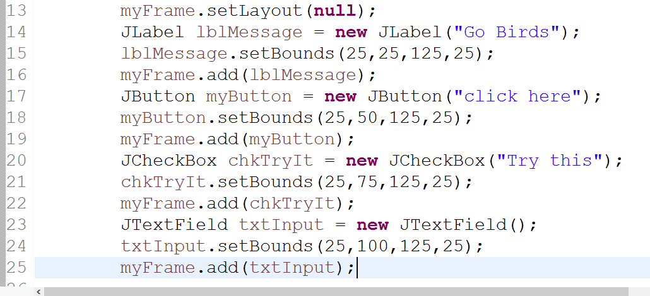
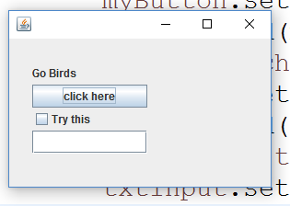
JTextField and JCheckBox
JTextField allows the user to input information. Retrieve the information with the getText() method.
JCheckBox is a checkbox. You can detect if a checkbox is checked with the isSelected() method
CheckBox
TextField

Slide 8
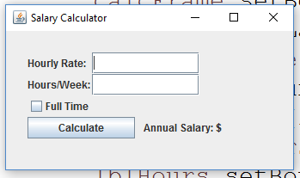
Homework (Salary Calculator)
Set up silimar to the frame below. When calculate is clicked, check to see if full time is clicked. If it is, hours/week need not be filled in, assume 40 hours per week, and calculate annual salary. If the checkbox is not checked, use rate and hours/week to calculate the annual salary. Make sure your frame has a title. (Double.parseDouble will be
necessary)

